Slide 1
C# Advanced Topics
Methods, Arrays, Lists, Dictionaries, Strings, Classes and Objects

Slide 2
Table of content
C# building blocks
Classes, fields, properties and methods
Objects and instances
Static and non-static classes
Collections
Arrays
Lists
Dictionaries
Extension methods

Slide 3

Classes
fields, properties and methods

Slide 4
Classes
The formal definition of class:
Definition by Google
Classes act as templates from which an instance of an object is created at run time. Classes define the properties of the object and the methods used to control the object's behavior.

Slide 5
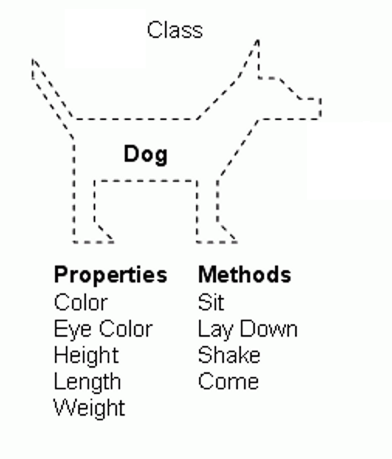
Classes
Classes provide the structure for objects
Define their prototype, act as template
Classes define:
Set of attributes
Represented by fields and properties
Hold their state
Set of actions (behavior)
Represented by methods
A class defines the methods and types of data associated with an object

Slide 6
Fields
Fields are data members of a class
Can be variables and constants (read-only)
Accessing a field doesn’t invoke any actions of the object
Just accesses its value
Constant fields can be only read
Variable fields can be read and modified
Usually properties are used instead of directly accessing variable fields

Slide 7
Properties
Properties look like fields
Have name and type
Can contain code, executed when accessed
Usually used as wrappers
To control the access to the data fields
Can contain more complex logic
Can have two components called accessors
get for reading their value
set for changing their value

Slide 8
Methods
Methods manipulate the data of the object to which they belong or perform other tasks
Examples:
Console.WriteLine(…)
Console.ReadLine()
Static methods are common for all instances of a class (shared between all instances)
Returned value depends only on the passed parameters
No particular class instance is available
Instance methods manipulate the data of a specified object or perform any other tasks
If a value is returned, it depends on the particular class instance

Slide 9
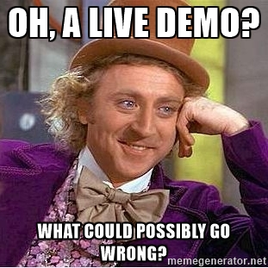
Class Demo

Slide 10
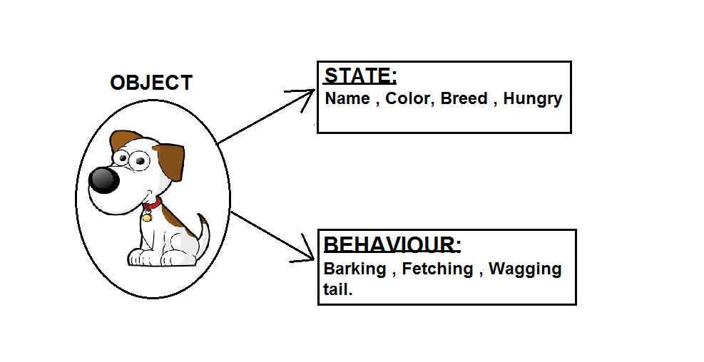
Objects and Instances

Slide 11
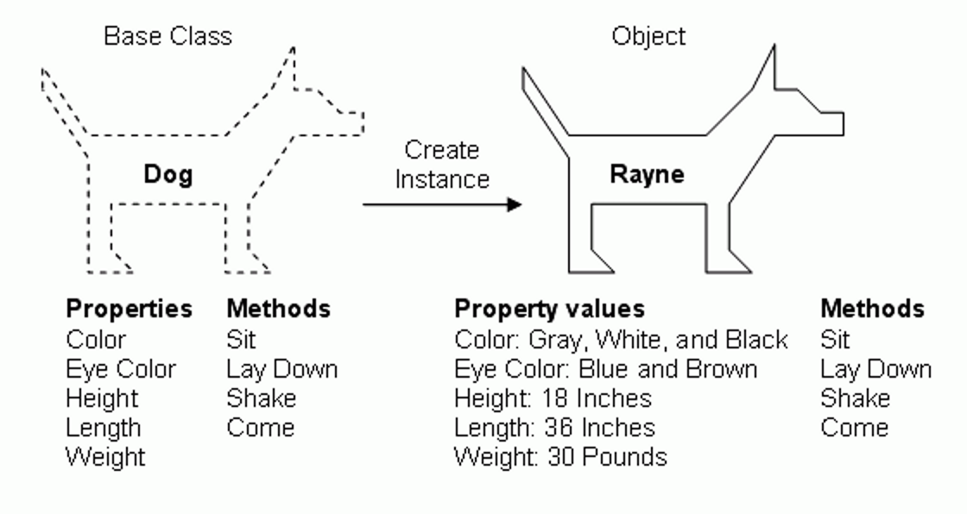
Objects and Instances

Slide 12
Objects and Instances
An object is a component of a program that knows how to perform certain actions and how to interact with other elements of the program.
Objects are the basic units of object-oriented programming
Code in object-oriented programming is organized around objects.
Once you have your objects, they can interact with each other to make something happen.

Slide 13
Objects and Instances
An object is a concrete instance of a particular class
Creating an object from a class is called instantiation
Objects have state
Set of values associated to their attributes
Objects have behavior
Set of methods to manipulate it’s state

Slide 14
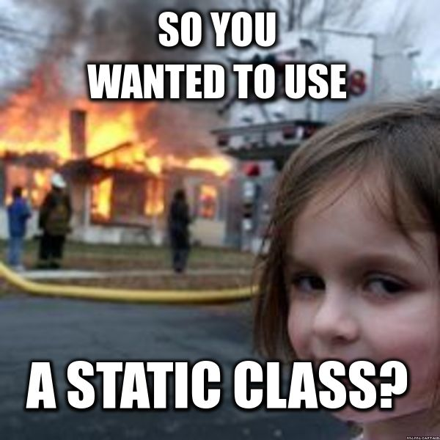
Static and Non-Static classes

Slide 15
Instance and Static Members
Fields, properties and methods can be:
Instance (or object members)
Static (or class members)
Instance members are specific for each object
Example: different dogs have different name
Static members are common for all instances of a class
Example: DateTime.MinValue is shared between all instances of DateTime

Slide 16
Instance and Static Members
Accessing instance members
The name of the instance, followed by the name of the member (field or property), separated by dot (".")
Accessing static members
The name of the class, followed by the name of the member
<instance_name>.<member_name>
<class_name>.<member_name>

Slide 17

Objects and Instances demo

Slide 18

Collections
Arrays, Lists, Dictionaries, Extension methods

Slide 19
Arrays
In programming array is a sequence of elements
All elements are of the same type
The order of the elements is fixed
Has fixed size (Array.Length)
0 1 2 3 4
Element index
Array of 5 elements
… | … | … | … | …
Element of an array

Slide 20
Arrays
Allocating an array of 10 integers:
Assigning values to the array elements:
Accessing array elements by index:
int[] numbers = new int[10];
for (int i = 0; i < numbers.Length; i++)
numbers[i] = i + 1;
numbers[3] = 20;
numbers[5] = numbers[2] + numbers[7];

Slide 21
Multidimensional Arrays
A multidimensional array (a.k.a. matrix) is an array containing one or more arrays
Elements are accessed by double indexing: arr[index, index]
Element is in row 0, column 2,
i.e. arr[0, 2]
One main array whose elements are arrays
0 1 2
0
1
2
4 | 6 | 3
2 | 1 | 2
6 | 7 | 9
Each sub-array contains its own elements

Slide 22

Arrays demo

Slide 23

Generic Lists

Slide 24
Lists
Lists are like resizable arrays
Allow add / remove / insert of elements
Lists in C# are defined through the List<T> class
Where T is the type of the list, e.g. string or int
List<int> numbers = new List<int>();
numbers.Add(5);
Console.WriteLine(numbers[0]); // 5

Slide 25
Lists
List<T> stores elements of the specified type and it grows automatically.
List<T> can store multiple null and duplicate elements.
List<T> can be assigned to IList<T>, ICollection<T>, IEnumerable<T> or List<T> type of variable. It provides more helper method When assigned to List<T> variable
List<T> can be access using indexer, for loop or foreach statement.
LINQ can be use to query List<T> collection.
List<T> is ideal for storing and retrieving large number of elements.

Slide 26

Lists demo

Slide 27

Dictionary
associative array

Slide 28
Dictionaries
Dictionary in C# is same as English dictionary. English dictionary is a collection of words and their definitions. In the same way, the Dictionary in C# is a collection of Keys and Values, where key is like word and value is like definition
A Dictionary stores Key-Value pairs where the key must be unique.
Before adding a Key-ValuePair into a dictionary, check that the key does not exist using the ContainsKey() method.
Use the TryGetValue() method to get the value of a key to avoid possible runtime exceptions.
Use a foreach or for loop to iterate a dictionary.
Use dictionary indexer to access individual item.

Slide 29
Dictionaries – major operations
Add(TKey,TValue) – adds an element with the specified key and value
Remove(TKey) – removes the element by key
this[] – get/add/replace of element by key
Clear() – removes all elements
Count – returns the number of elements
Keys – returns a collection of the keys
Values – returns a collection of the values
ContainsKey(TKey) – checks whether the dictionary contains given key
TryGetValue(TKey, out TValue)
If the key is found, returns it in the TValue
Otherwise returns false

Slide 30

Dictionaries demo

Slide 31


Extension methods
System.LINQ

Slide 32
Anonymous types
Anonymous types
Encapsulate a set of read-only properties and their value into a single object
No need to explicitly define a type first
To define an anonymous type
Use of the var keyword in conjunction with the object initialization syntax
At compile time, the C# compiler will autogenerate an uniquely named class
The class name is not visible from C#
Using implicit typing (var keyword) is mandatory
var point = new { X = 3, Y = 5 };

Slide 33
Lambda expressions
A lambda expression is an anonymous function containing expressions and statements
Used to create delegates or expression tree types
All lambda expressions use the lambda operator =>, which is read as "goes to"
The left side of the lambda operator specifies the input parameters
The right side holds the expression or statement

Slide 34
Lambda expressions
Lambda Expression is a shorter way of representing anonymous method.
Lambda Expression syntax: parameters => body expression
Lambda Expression can have zero parameter.
s => s.Age > 12 && s.Age < 20
() => Console.WriteLine("Parameter less lambda expression")

Slide 35
Lambda expressions
Lambda Expression can have multiple parameters in parenthesis ()
Lambda Expression can have multiple statements in body expression in curly brackets {}.
(s, youngAge) => s.Age >= youngAge
(s, youngAge) =>
{
Console.WriteLine(“Multiple statements in the body");
Return s.Age >= youngAge;
}

Slide 36
Advantages of LINQ
Familiar language: Developers don’t have to learn a new query language for each type of data source or data format.
Less coding: It reduces the amount of code to be written as compared with a more traditional approach.
Readable code: LINQ makes the code more readable so other developers can easily understand and maintain it.
Standardized way of querying multiple data sources: The same LINQ syntax can be used to query multiple data sources.
Compile time safety of queries: It provides type checking of objects at compile time.
IntelliSense Support: LINQ provides IntelliSense for generic collections.
Shaping data: You can retrieve data in different shapes.

Slide 37
Syntax of LINQ
Query (Comprehension) Syntax
Lamda (Method) Syntax
var longwords = from w in words where w.length > 10;
var longWords = words.Where( w => w.length > 10);

Slide 38
Language Integrated Query (LINQ) query keywords
from – specifies data source and range variable
where – filters source elements
select – specifies the type and shape that the elements in the returned sequence
group – groups query results according to a specified key value
orderby – sorts query results in ascending or descending order

Slide 39
Query syntax example
int[] numbers = { 5, 4, 1, 3, 9, 8, 6, 7, 2, 0 };
var querySmallNums =
from num in numbers
where num < 5
select num;
foreach (var num in querySmallNums)
{
Console.Write(num.ToString() + " ");
}
// The result is 4 1 3 2 0

Slide 40
Lambda Method syntax example
int[] numbers = { 5, 4, 1, 3, 9, 8, 6, 7, 2, 0 };
var querySmallNums =
numbers.Where(n => n < 5);
foreach (var num in querySmallNums)
{
Console.Write(num.ToString() + " ");
}
// The result is 4 1 3 2 0

Slide 41
Expression trees
A query expression tree is an efficient data structure representing a LINQ expression
Type of abstract syntax tree used for storing parsed expressions from the source code
Lambda expressions often translate into query expression trees
IQueryable<T> is interface implemented by query providers (e.g. LINQ to SQL, LINQ to XML, LINQ to Entities)
IQueryable<T> objects use expression trees

Slide 42
LINQ demo

Slide 43

Any questions

